Slide 1
Web Sergeant
2023 Southern Division Conference
Tyler, TX

Slide 2
Web Sergeant
What is a Web Sergeant?
Do you need a Web Sergeant?
Who should be a Web Sergeant?
Duties & Responsibilities.
Websites.
Social Media.
Digital Media.

Slide 3
What is a web sergeant?
The person who manages your online media.
An Appointed Regular Member or Associate Member in Good Standing.
Should be knowledgeable with cell phones, computers, the internet, social media, and websites.

Slide 4
Do y0u need a web Sergeant?
National has requested that all Detachments, Departments, and Divisions to have a Web Sergeant appointed .
We are in a digital world where we need to compete with cell phones and tablets.

Slide 5
Who should be a Web sergeant?
Should be a member who is knowledgeable with computers, the internet, social media, and websites.
A member who understands the latest trends in digital media.
Someone who is willing to learn, improvise, adapt and overcome.

Slide 6
Web sergeant Duties and Responsibilities
Keep your Website up to date.
Post daily in Social Media.
Promote your Website and Social Media Accounts.
Should work with all officers, to get out information to all members, either by text or email.

Slide 7
Who are Our Department web sergeants?
Arkansas – Ken Summers
Oklahoma – David Easter
Texas – Sean Downey

Slide 8
Digital media

Slide 9
Digital Media, what is it?
Internet
Websites
Social Media
Digital Photography
Digital Videography
Digital Graphics
Online Advertising
Zoom
Microsoft Teams
A way of communication.

Slide 10

Digital media Helpful programs
Canva
Microsoft Publisher
Adobe
Corel
www.techsoup.com

Slide 11
websites

Slide 12
What should go on your website?
Mission Statement
About the Marine Corps League, your Department, or Detachment.
Who your officers are.
Programs
Events
Gallery
Contact information
Meeting Information
Links to National, Southern Division, Department, and Detachment Websites.
How to Donate.
Disclaimer
Links to Social Media
Your websites should be phone and tablet friendly.

Slide 13
What should not go on your website.
Members’ personal information.
Federal EIN (Tax ID number)
Anything negative about the Marine Corps or Marine Corps League.

Slide 14
disclaimer
“The Eagle, Globe and Anchor emblem and the name Marine Corps® are registered trademarks of the USMC. The Marine Corps League and its subordinate organizations support the USMC and its veterans, however it is not officially connected to or endorsed by the USMC, and the name and emblem are used with permission.”
All websites and social media pages MUST HAVE THIS DISCLAIMER, This is required by National.

Slide 15
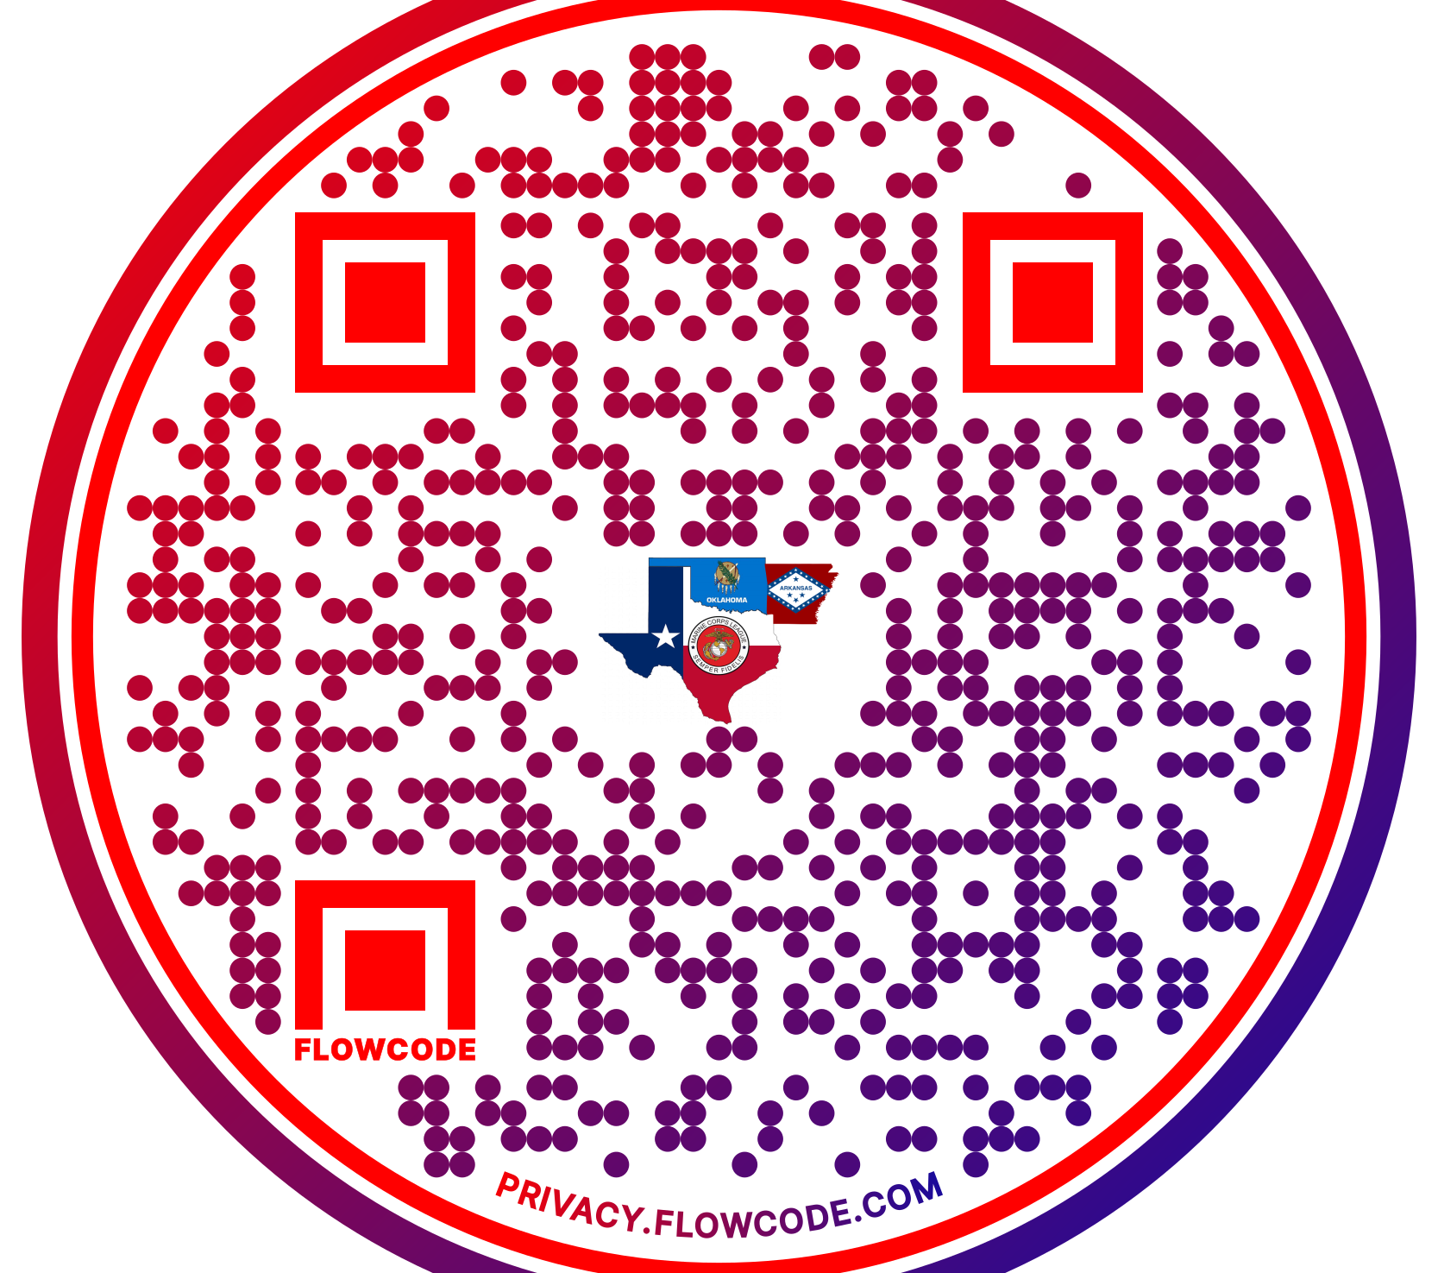
QR code
Quick Response Code
Make a QR Code.
Add it to your business cards.
Make stickers.
Put them on your vehicle’s back windows.
Print them off and laminate them.

Slide 16

Sponsors & Advertisers
Recruit sponsors and advertisers.
It is a great way to pay for your website.
Generates extra revenue to help with your projects.
Local Businesses are great options.

Slide 17
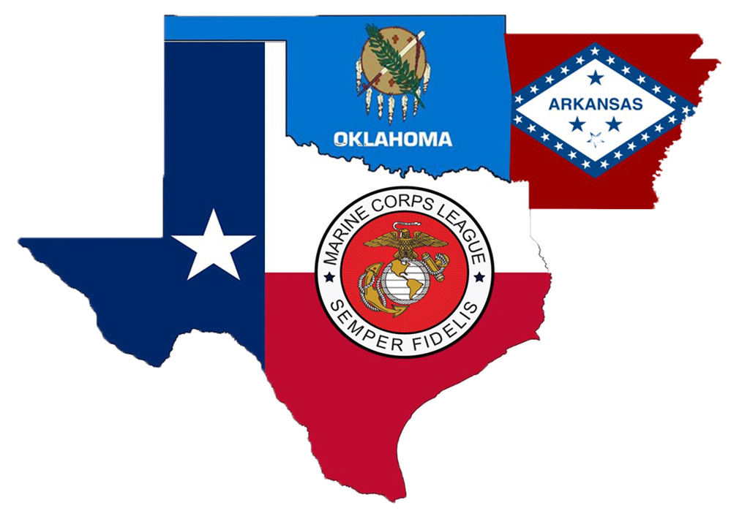
Important Websites for the southern Division
www.mclnational.org
www.mclsouth.org
www.mclar.org
www.mclok.org
www.txmcl.org

Slide 18
Social media

Slide 19
Why Social Media?
Social media is a great way to communicate with your members.
Can help with recruitment.
Lets everyone know about upcoming events and fundraisers.

Slide 20

Twitter
Twitter users make short statements called tweets.
Pros:
Easy and fast to create and post.
Cons:
Must post multiple times per day.
Average lifespan of a tweet is only a few seconds.

Slide 21

Tic tok
Tik Tok is a video making and sharing social media site.
Pros:
Make Short Video Clips.
Good videos tend to go viral and shared across all platforms.
One of go to aps for younger generations.
Cons:
Controversial.

Slide 22

You Tube
Video Creating and Sharing Platform.
Pros:
Make your own Channels.
Able to create long videos.
You can go live.
Make instructional videos.
Post videos of meetings and events.
Make recruitment videos and ads.
A go to with most of the younger generation.

Slide 23

LinkedIN
LinkedIn is a professional networking platform.

Slide 24

Facebook
Facebook is an all-around social media platform.
Pros:
You can post stories, photos, videos, files, etc.
You can create private groups.
You can create business pages.
You can live stream.
Meta Business Suite.
Cons:
Youth considers this platform for the older generation.

Slide 25

Instagram
Photo and video story sharing platform.
Pros:
Post and Share Photos.
Make Short Video Clips.
Good videos tend to go viral and shared across all platforms.
Meta Business Suite.
One of go to aps for younger generations.

Slide 26

Meta business suite
Pros:
Link both Facebook and Instagram together.
Create and schedule posts for both platforms.
Create Ads.
Cons:
Can only create and schedule posts for pages only.
Cannot post in Facebook Groups.

Slide 27

Facebook
Messenger
Instant private messaging and chat in Facebook and Instagram.
Pros:
Group messaging.
Instant Chat.
Group Instant Chat.
Cons:
Cannot be used with Meta Business Suite.
Cannot be used with Facebook Groups.

Slide 28
Resources and information

Slide 29
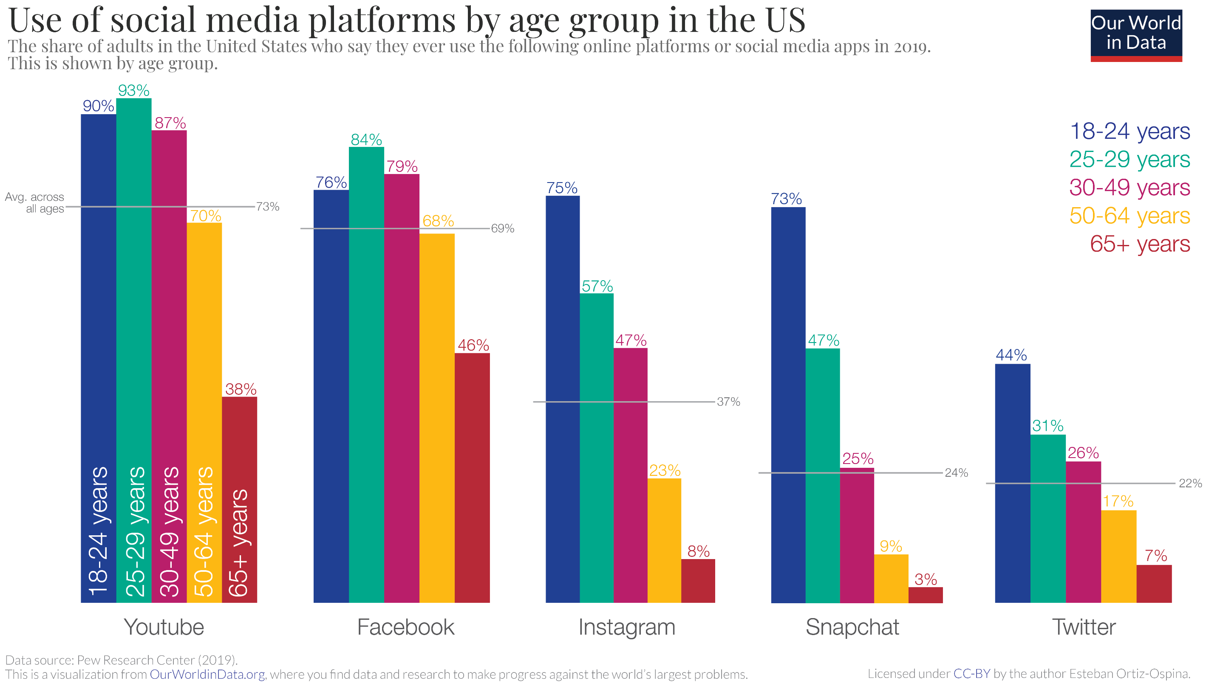

Slide 30
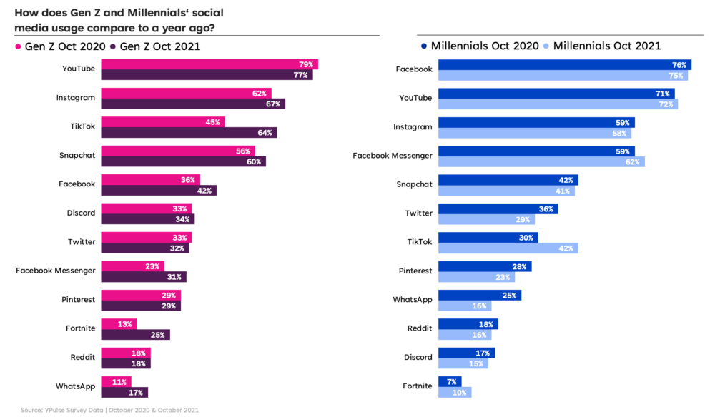

Slide 31
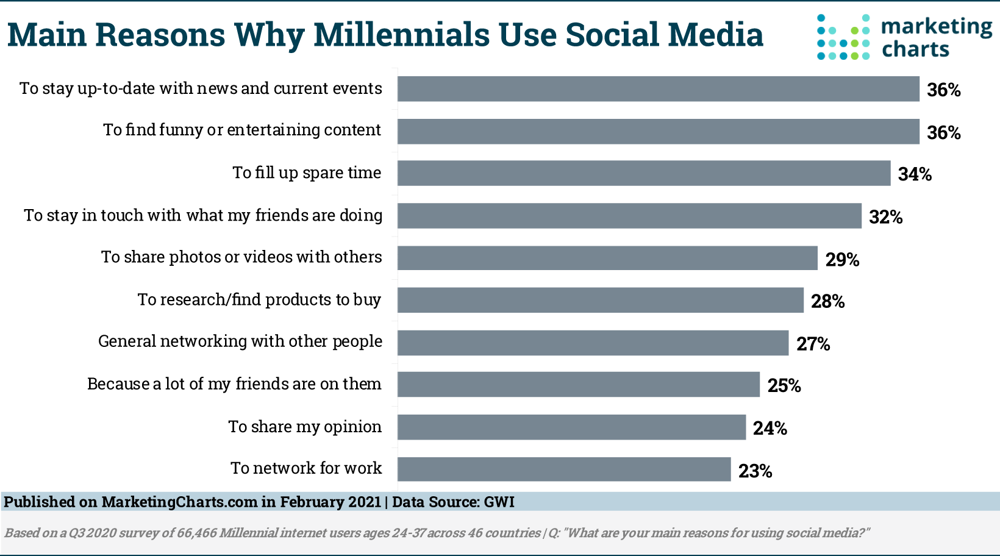

Slide 32
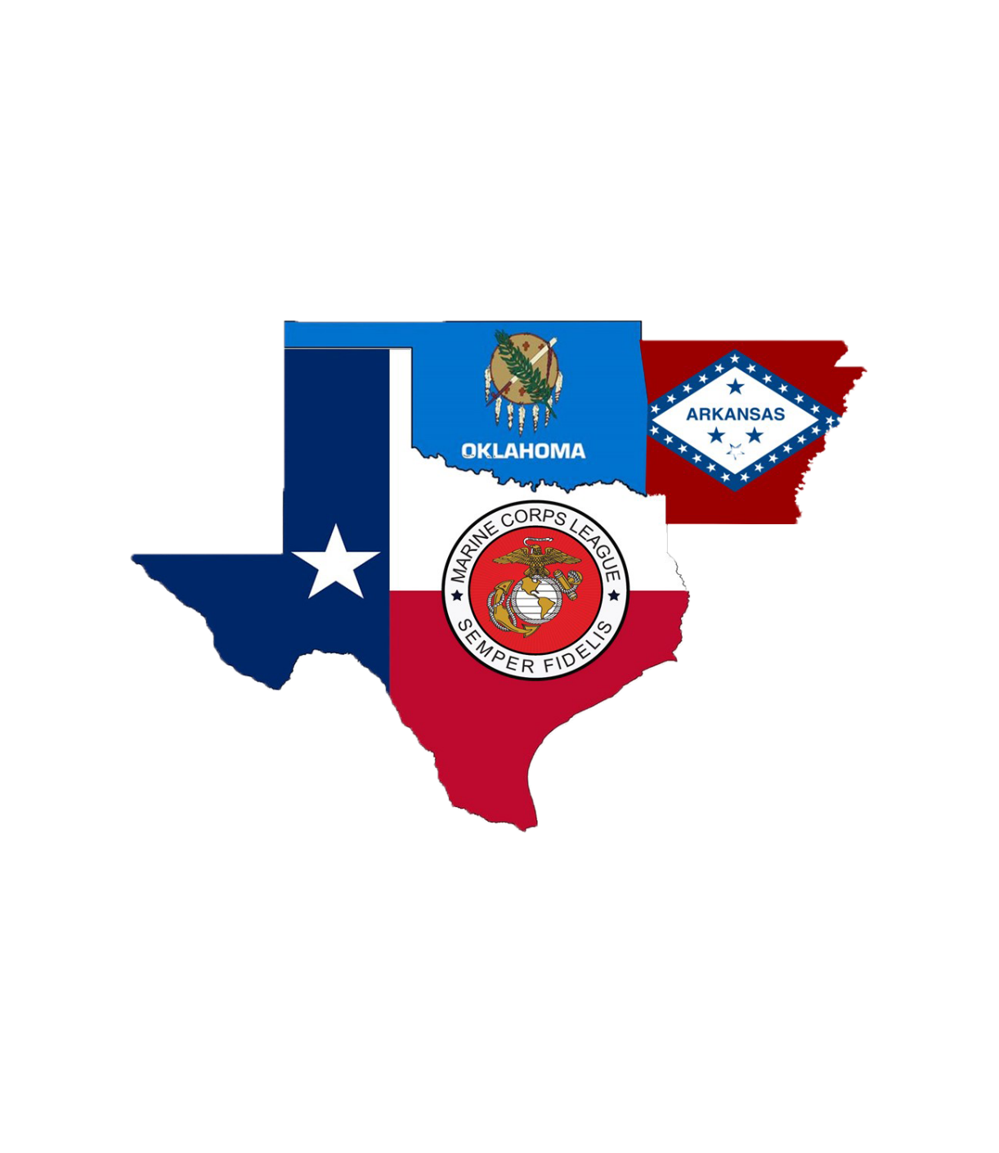
Southern Division Websites
www.mclsouth.org – MCL Southern Division Website
www.mclar.org – MCL Department of Arkansas Website
www.mclok.org – MCL Department of Oklahoma Website
www.txmcl.org – MCL Department of Texas Website

Slide 33
Helpful websites
www.mclnational.org – MCL national website
www.mcleaguelibrary.org – MCL national public documents /
resources
www.mcleaguelibrary.org/member-library - Password protected,
ask your local leadership for this password. This library holds
meeting minutes, forms, national bylaws / administrative
procedures manuals to include MCL uniform guidance and MCL
awards guidance, etc.
www.nedmcl.org – MCL Northeast Division website
www.mclsouth.org – MCL Southern Division Website
www.pamcleague.com – MCL Department of Pennsylvania
website
www.mclar.org – MCL Department of Arkansas Website
www.mclok.org – MCL Department of Oklahoma Website
www.txmcl.org – MCL Department of Texas Website

Slide 34
Facebook pages
www.facebook.com/mclnational - MCL National
www.facebook.com/northeastdivmcl - MCL Northeast Division
www.facebook.com/MCLDEPTPA - MCL Department of
Pennsylvania
www.facebook.com/groups/mclhonorguardandcolorguard - MCL
Honor Guard / Color Guard
www.facebook.com/groups/447677227018622 - MCL National
Membership Committee
www.facebook.com/groups/mcluniforms - MCL Uniforms Buy-
Sell-Trade
www.facebook.com/groups/mclconnections - MCL Connections
(MCL members only)
www.facebook.com/groups/usmccollectibles

Slide 35
Other useful resources
www.youtube.com/themarinecorpsleague - Click "subscribe” for new
content.
www.instgram.com/hqmcl– MCL National Instagram
www.militaryorderofthedevildogs.org – MODD Kennel website
www.nationalmcla.org – MCL National Auxiliary
www.linkedin.com/company/marine-corps-league - MCL
National LinkedIn
We encourage you all as members to visit these websites and social media pages. Take a look around and know all the resources available to you on these platforms. Please share this information with all members not only in leadership positions, but your Detachment members.
Questions about any of these resources can be addressed directly to your Leadership or you are welcome to contact the MCL National Public Relations Committee for assistance.
publicrelations@mcleague.org

